Slide 1
Capstone project
Sakshi Shekhar
​

Slide 2
hotel booking cancellation
Introduction​
Primary goals
Algorithm used
​Summary​

Slide 3
Introduction
This data set contains booking information for a city hotel and a resort hotel. It includes information such as when the booking was made, length of stay, the number of adults, children, and/or babies, and the number of available parking spaces, among other things.
All personally identifying information has been removed from the data.
My Data set’s shape contains 1,19,390 rows and 32 columns
+

Slide 4
PRIMARY GOALS

Slide 5
Exploratory data analysis
From where the most guests are coming ?
How much do guests pay for a room per night?
How does the price vary per night over the Month?
Which are the most busy months?
How long do people stay at the hotels?

Slide 6
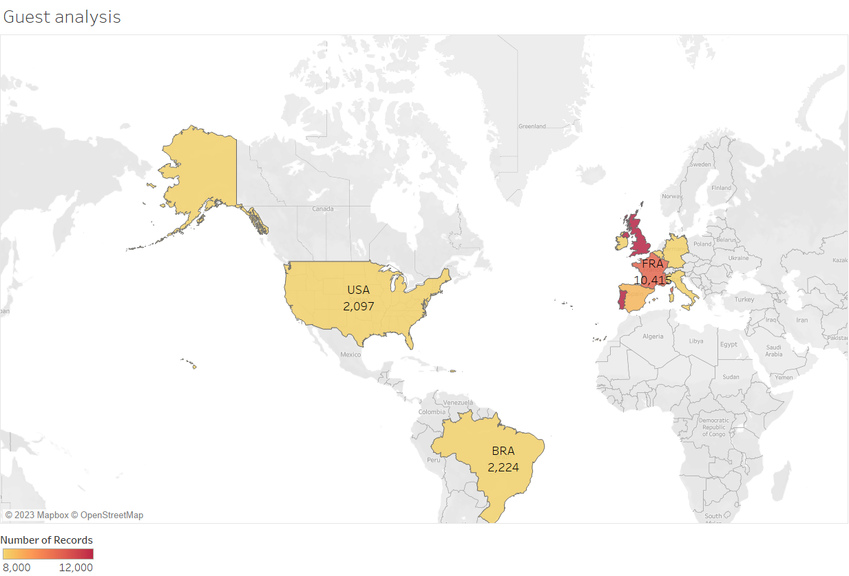
From where the most guests are coming ?
People from all over the world are staying in these two hotels. Most guests are from Portugal and other countries in Europe

Slide 7
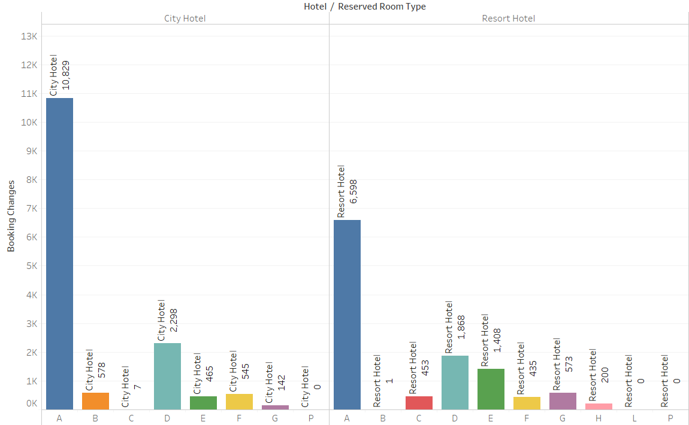
How much do guests pay for a room per night?
The figure shows that the average price per room depends on its type and the standard deviation

Slide 8
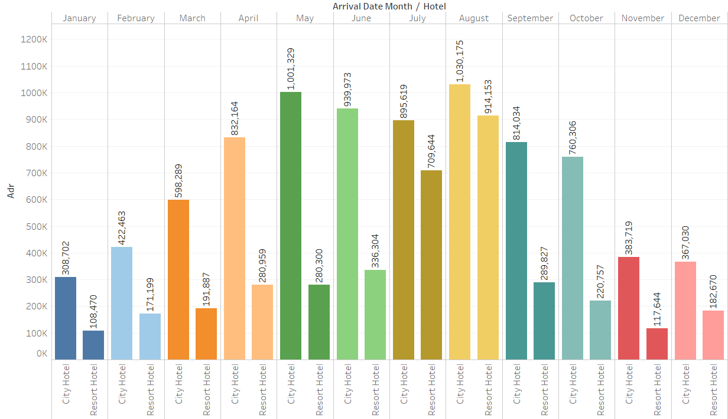
How does the price vary per night over the Month?
Adr:- Average Daily Rate as defined by dividing the sum of all lodging transactions by the total number of staying nights
The figure shows that the average price per room depends on its type and the standard deviation

Slide 9
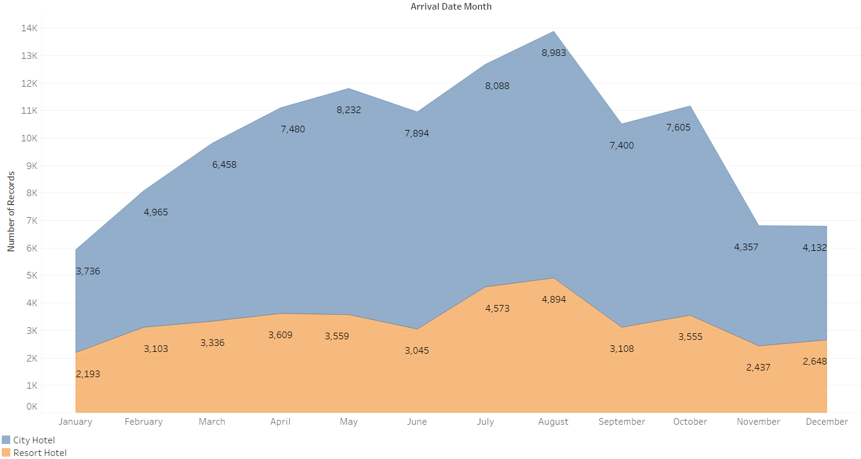
Which are the most busy months?

Slide 10
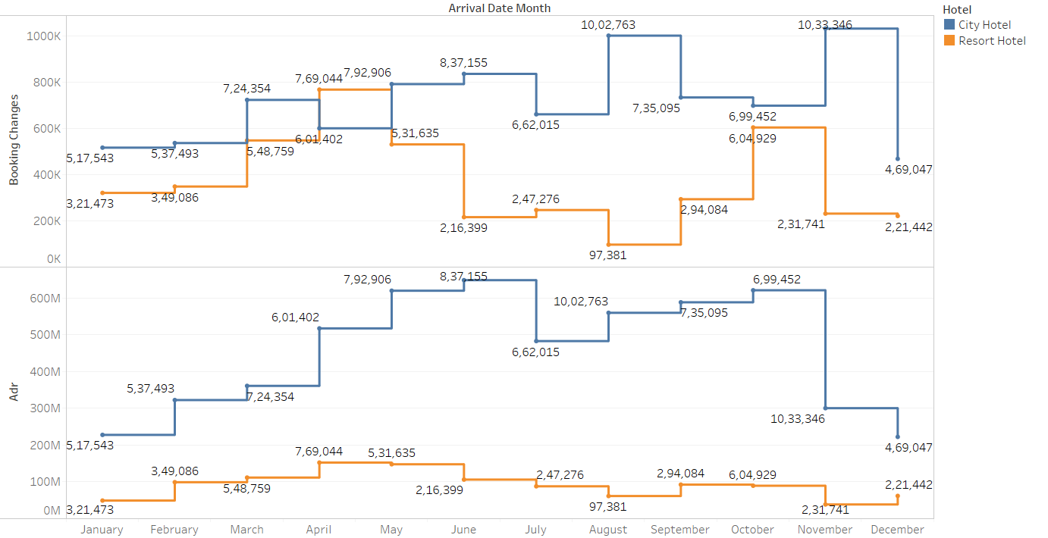
This plot clearly shows that prices in the Resort Hotel are much higher during the summer and prices of City hotel varies less and is most expensive during Spring and Autumn .

Slide 11
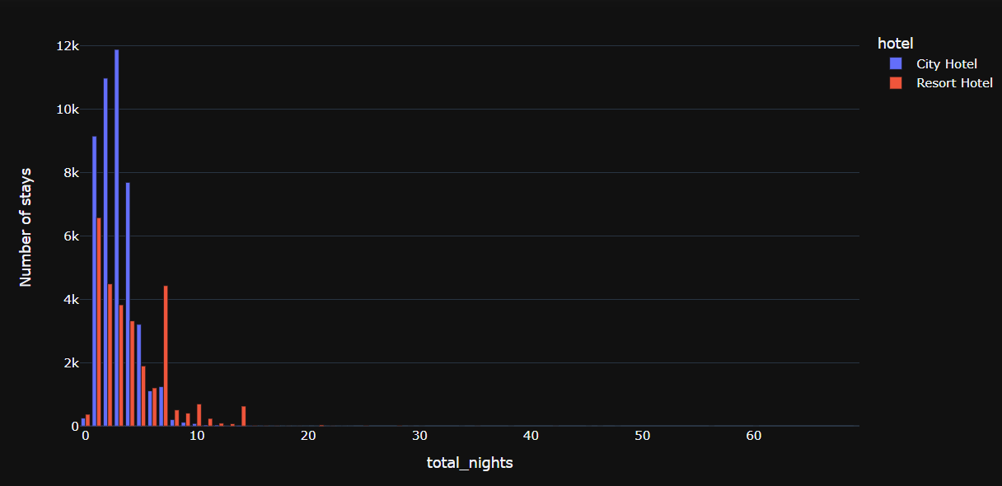
How long do people stay at the hotels?
in City Hotel people maximum stays for 3 nights,then 2 night.
In Resort Hotel people maximum stays for 1 nights,then 2 night.

Slide 12


Algorithm used
Logistic Regression
Knn
Decision Tree Classifier
Random Forest Classifier

Slide 13
Algorithm used
 | Accuracy | Precision(0) | Recall(0) | f1-score(0)
Logistic Regression | 0.74 | 0.76 | 0.87 | 0.81
KNN | 0.91 | 0.90 | 0.97 | 0.93
Decision Tree Classifier | 0.93 | 0.94 | 0.95 | 0.95
Random Forest Classifier | 0.94 | 0.92 | 0.98 | 0.95

Slide 14
If someone reports close to 100% accuracy, they are either lying to you, made a mistake, forecasting the future with the future, predicting something with the same thing, or rigged the problem
“
”
Matthew Schneider

Slide 15
SUMMARY
EDA is done to know the data set to work properly on data set. We have applied 4 kinds of classification algorithms to train the model. By using different classification accuracy is compared of each algorithm to get the best result for the client .

Slide 16
THANK YOU
​

